Slide 1
Catheter Care in Haemodialysis

Slide 2
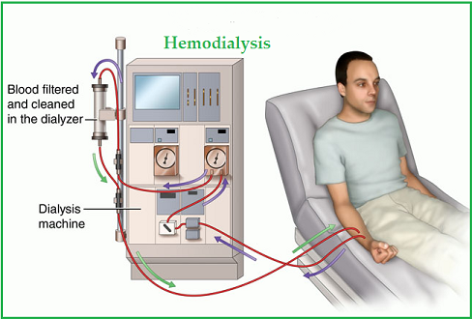
Haemodialysis
Most common method used to treat advanced & permanent kidney failure.
Process to purify the blood of a person whose kidneys are not working normally.
Achieves extracorporeal removal of waste products such as creatinine, urea & free water from the blood.

Slide 3
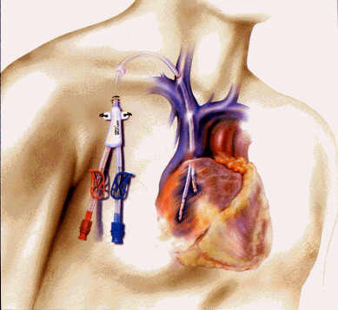
Dialysis Catheter and its Need
For dialysis to work there must be a way of taking blood from the body, pumping it into the kidney machine & then back to the bloodstream.
A dialysis catheter (sometimes called a “line”) is one way of doing this and it can be used more or less straight away.

Slide 4
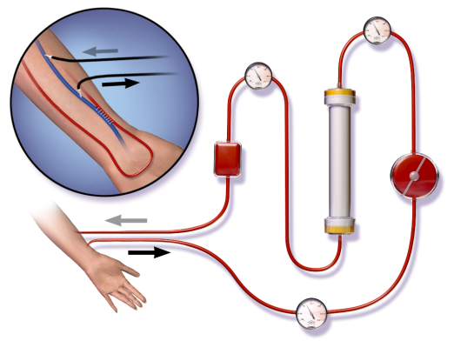
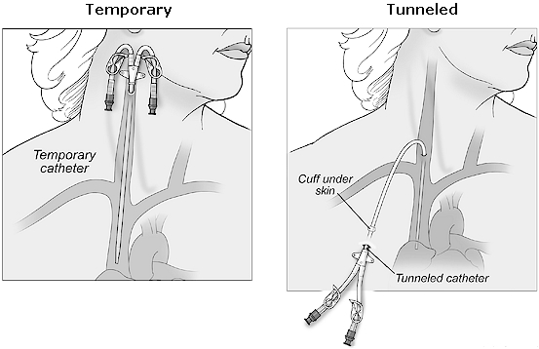
Types of Dialysis Catheter
In a patient receiving haemodialysis, the access is one of the following:
An AV fistula made by joining an artery and vein in your arm
An AV graft made by using a soft tube to join an artery and vein in your arm
A catheter, a soft tube that is placed in a large vein, usually in your neck

Slide 5
Risks Associated with Poor Cannulation & Improper Care of Fistula
Access survival depends on quality of needle puncture.
Error in sticking of needles can shorten survival of the access & the patient.
Loss of the fistula
Further hospitalization
Creation of temporary access measures
Inconvenience
Disrupt of regular treatment regimen
Higher treatment costs

Slide 6
Check AVF & AVG
Thrill: is a bussing pulsation or rushing sensation you feel it when you check for the blood flow along the access
Bruit: is the whooshing noise you here it by the stethoscope along the access

Slide 7
Physical Assessment
Assess AVF before every cannulation
Compare arms for changes in skin colour, circulation, integrity
Inspect
Access extremity for central or outflow vein stenosis
Distal areas of extremity for steal syndrome
Access for vessel size, cannulation areas , infection and aneurysms
Plapate
Temperature change may mean infection or stenosis
Change in thrill may mean stenosis
Auscultate
Listen to entire access for changes in bruit that indicate stenosis

Slide 8
Specific Infection Control Precautions
Wear gloves and other personal protective equipment (PPE) for all patient care
Promote vascular access safety
Separate clean areas from contaminated areas
Use medication vials safely
Clean and disinfect the dialysis station between patients
Perform safe handling of dialyzers
Notes:
Some of the specific infection control recommendations for outpatient hemodialysis healthcare workers include:
Wear gloves and other personal protective equipment or PPE for all patient care
Promote vascular access safety
Clean and disinfect the dialysis station between patients
Separate clean areas from contaminated areas
Use medication vials safely
Perform safe handling of dialyzers
We will learn more about each of these concepts in the following slides.

Slide 9
Wear Gloves During Patient Care
Wear disposable gloves when caring for the patient or touching equipment at the dialysis station
Wear gloves when cleaning surfaces in the environment or medical equipment
Remember to remove gloves and perform hand hygiene between each patient or station, and if moving from a contaminated to clean area of the same patient or within the same dialysis station
Notes:
The first dialysis specific infection control recommendation is to wear gloves during patient care. You should wear gloves for your own protection from infections, and you have to use them correctly to protect your patients from infections. During the process of hemodialysis, exposure to blood and contaminated items can be expected; therefore, gloves are required in the dialysis environment whenever caring for a patient or touching equipment or surfaces at the dialysis station. Gloves should also be worn when cleaning surfaces in the environment or medical equipment. Remember to remove your gloves and perform hand hygiene between each patient or station and if moving from a contaminated to a clean area of the same patient or within the same dialysis station.
These practices will help prevent the spread of infections.

Slide 10
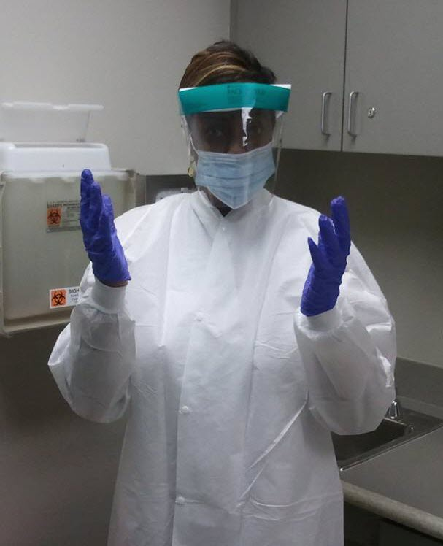
Use Personal Protective Equipment (PPE)
In addition to gloves, you should wear gowns & face protection to protect yourself as needed:
During initiation and termination of dialysis
When cleaning dialyzers
When handling lab samples
PPE should be changed if it becomes dirty
Notes:
Similarly, while personal protective equipment is a concept of Standard Precautions, it is also a concept of dialysis-specific infection control recommendations. You should wear gloves, gowns, and face protection such as a face shield or goggles and a face mask to protect yourself when performing procedures during which blood splashes might occur. This includes during initiation and termination of dialysis, when cleaning dial yzers, and when spinning blood samples. Personal protective equipment should be changed if it becomes soiled with blood, body fluids, secretions, or excretions.

Slide 11
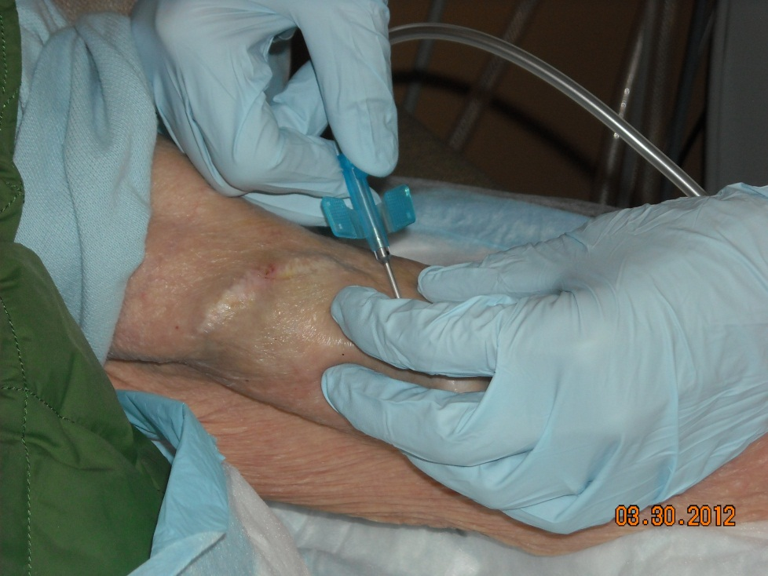
Basic Steps in Fistula/Graft Care
Cannulation Procedure:
Wash the site
Perform hand hygiene
Put on a new, clean pair of gloves
Wear proper face protection
Apply skin antiseptic and allow it to dry
Insert needle using aseptic technique
Remove gloves and perform hand hygiene
Notes:
The next concept in the dialysis-specific infection control recommendations is practicing vascular access safety. As we learned in lesson 1, infections are all too common, particularly with central lines. In the next four slides, we will review the cannulation and decannulation procedures for patients who have fistulas or grafts, followed by the connection and disconnection procedures for patients who have catheters.
One concept that we will mention in these next several slides is aseptic technique. When performing a procedure such as cannulating a fistula or graft, aseptic technique means taking great care not to contaminate the fistula or graft site before or during the procedure.
Here we describe the cannulation procedure for patients with fistulas or grafts:
Have the patient wash the site with soap and water
Perform hand hygiene
Put on a new, clean pair of gloves
Wear proper face protection
Apply skin antiseptic such as chlorhexidine, povidone iodine, or alcohol to the site and allow it to dry
Perform cannulation being careful not to contaminate the area that has been cleansed
Remove gloves and perform hand hygiene
CDC recommends using safety needles to decrease your chances of getting a needlestick.

Slide 12
Basic Steps in Fistula/Graft Care
Decannulation Procedure:
Perform hand hygiene
Put on a new, clean pair of gloves
Wear proper face protection
Remove needles using aseptic technique
Apply clean gauze/bandage to site
Compress the site with clean gloves
Remove gloves and perform hand hygiene
Notes:
When the patient has completed treatment, here are the steps for the decannulation procedure in patients with fistulas or grafts:\
Perform hand hygiene
Put on a new, clean pair of gloves
Wear proper face protection
Activate the safety devices on the needles to prevent a needlestick, remove needles using aseptic technique and dispose of them in a proper sharps container
Apply clean gauze or a bandage to site
Compress the site with clean gloves
Remove gloves and perform hand hygiene

Slide 13
Basic Steps in Catheter Care
Catheter Connection Procedure:
Perform hand hygiene
Put on a new, clean pair of gloves
Wear proper face protection
Apply antiseptic to catheter hub and allow it to dry
Connect the catheter to blood lines using aseptic technique
Unclamp the catheter
Remove gloves and perform hand hygiene
Notes:
Practicing vascular access safety is of particular importance in patients with catheters or central lines, as the risk of infection is highest in these patients. To properly perform a catheter connection procedure, use the following steps:
Perform hand hygiene.
Put on a new, clean pair of gloves. Some centers may choose to use sterile gloves.
Wear proper face protection. A face mask may be required in your center.
While keeping the catheter clamped, apply antiseptic to the catheter hub, which is the end of the catheter, and allow it to dry. Be careful not to contaminate the catheter hub after applying the antiseptic.
Connect the catheter to blood lines using aseptic technique. Keep the catheter clamped until after it’s connected to avoid allowing air to enter the catheter.
Unclamp the catheter once it is connected.
Remove gloves and perform hand hygiene.

Slide 14
Basic Steps in Catheter Care
Catheter Disconnection Procedure:
Perform hand hygiene
Put on a new, clean pair of gloves
Wear proper face protection
Disconnect the catheter from blood lines using aseptic technique
Apply antiseptic to catheter hub and allow it to dry
Replace caps using aseptic technique
Make sure the catheter remains clamped
Remove gloves and perform hand hygiene
Notes:
When the patient has completed treatment, here are the steps for the disconnection procedure in patients with catheters:
Perform hand hygiene.
Put on a new, clean pair of gloves. Some centers may choose to use sterile gloves.
Wear proper face protection. A face mask may be required in your center.
After clamping the catheter, disconnect the catheter from the blood lines using aseptic technique.
Apply antiseptic to the catheter hub and allow it to dry.
Replace caps using aseptic technique.
Check to make sure the catheter remains properly clamped.
Remove gloves and perform hand hygiene.

Slide 15
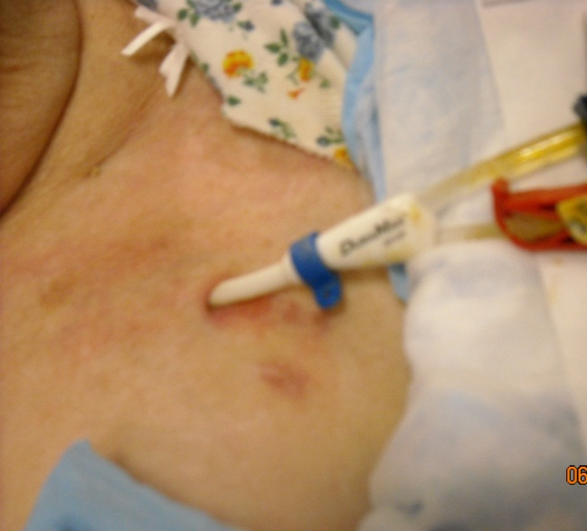
Catheter Exit Site Care
Perform hand hygiene
Put on a new, clean pair of gloves
Wear a face mask if required
Apply antiseptic to catheter exit site & allow it to dry
Apply antimicrobial ointment
Apply clean dressing to exit site
Remove gloves and perform hand hygiene
Notes:
Here are the additional steps for caring for a catheter exit site. This can be done anytime prior to, during, or after dialysis treatment:
Perform hand hygiene
Put on a new, clean pair of gloves. Some centers may choose to use sterile gloves.
Wear a face mask if required in your center.
Apply antiseptic to catheter exit site and allow it to dry
Apply antimicrobial ointment
Apply clean dressing to exit site
Remove gloves and perform hand hygiene

Slide 16
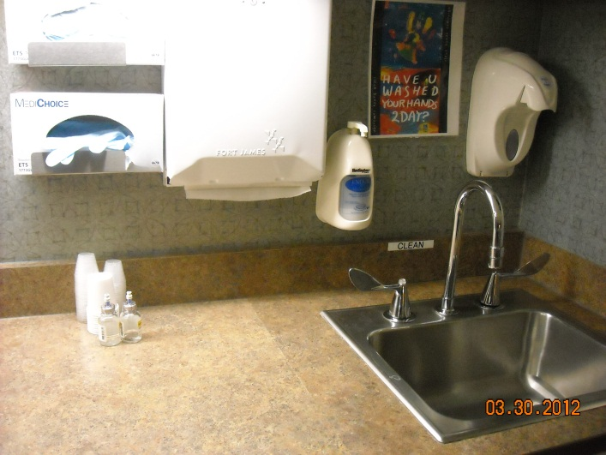
Separate Clean Areas from Contaminated Areas
Clean areas should be used for preparation, handling & storage of medications & unused supplies and equipment
Contaminated areas are where used supplies & equipment are handled
Do not handle or store medications or clean supplies in the same area as where used equipment or blood samples are handled
Remember: Treatment stations are contaminated areas!
Notes:
The next concept in the dialysis-specific infection control recommendations is keeping clean areas separate from contaminated areas.
Clean areas should be clearly designated and used only for the preparation, handling and storage of medications and unused supplies and equipment.
In your center, there should be clean medication and clean supply areas. Ideally these are in a separate room, physically separate from the rest of the treatment area, which allows you to better maintain the cleanliness of the area.
Clean areas should be clearly separated from contaminated areas where used supplies and equipment are handled.
Do not handle or store medications or clean supplies in the same area as where used equipment or blood samples are handled.
Remember: treatment stations are contaminated areas!

Slide 17
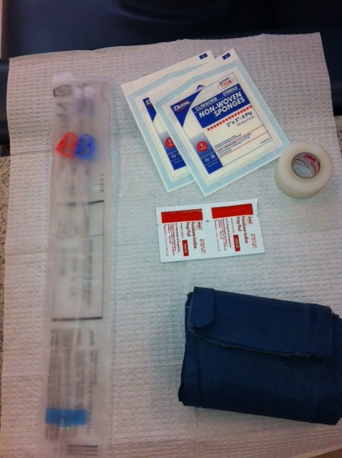
Dedicate Supplies to a Single Patient
Any item taken to a patient’s dialysis station could become contaminated
Items taken into the dialysis station should either be:
Disposed of, or
Cleaned & disinfected before being taken to a common clean area or used on another patient
Unused medications or supplies taken to the patient’s station should not be returned to a common clean area (e.g., medication vials, syringes, alcohol swabs)
Notes:
The next concept in the dialysis-specific infection control recommendations is to dedicate supplies to a single patient. Any item taken to a patient’s dialysis station could become contaminated with blood or other body fluids.
Patient care items taken into the dialysis station should either be:
Disposed of, or
Cleaned and disinfected before being taken to a common clean area or used on another patient.
Unused medications or supplies, for example, medication vials, syringes, or alcohol swabs, that are taken to the patient’s station should not be returned to a common clean area.

Slide 18
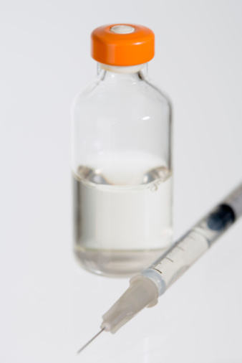
Safe Use of Medication Vials
Prepare all individual patient doses in a clean area away from dialysis stations.
Prepare doses as close as possible to the time of use
Do not carry medications from station to station
Do not prepare or store medications at patient stations
CDC recommends that dialysis facilities:
Use single-dose vials whenever possible & dispose them immediately after use
Notes:
The next concept in the dialysis-specific infection control recommendations is to practice safe use of medication vials. These recommendations are part of safe injection practices under standard precautions for all healthcare workers.
Most of your patients will require injected medications such as heparin, saline, or erythropoietin. When preparing these medications:
Prepare all individual patient doses in a clean area away from dialysis stations.
Prepare doses as close as possible to the time of use, meaning, do not draw up medications in advance.
Do not carry medications from station to station.
Do not prepare or store medications at patient stations.
CDC recommends that dialysis facilities:
Use single-dose vials whenever possible and dispose of them immediately after use.

Slide 19
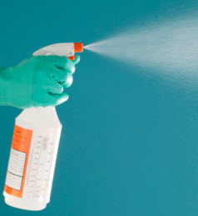
Cleaning & Disinfecting Dialysis Station
Cleaning & disinfection reduce the risk of spreading an infection.
Cleaning is done using cleaning detergent, water and friction, and is intended to remove blood, body fluids, and other contaminants from objects and surfaces.
Disinfection is a process that kills many or all remaining infection-causing germs on clean objects and surfaces
Use an EPA-registered hospital disinfectant
Follow label instructions for proper dilution
Wear gloves during the cleaning/disinfection process
Notes:
The next concept in the dialysis-specific infection control recommendations is cleaning and disinfecting the dialysis station. Both cleaning and disinfection are performed to reduce the risk of spreading an infection.
Cleaning is done using cleaning detergent and water and is intended to remove blood and body fluids from objects and surfaces.
Disinfection is a process that kills many or all of the remaining germs on clean objects and surfaces. To properly perform disinfection, use an EPA-registered hospital disinfectant. Follow the label instructions for proper dilution.
Note that different disinfectants will have different instructions for making up the solution and this can vary for routine disinfection versus cleaning up a blood spill. Be sure to check the label.
Also, be sure to wear gloves and other PPE that is recommended on the product’s label during the cleaning and disinfection process.

Slide 20
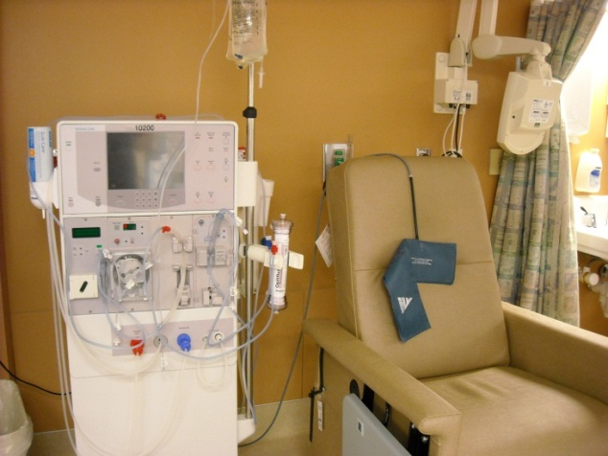
Disinfecting the Dialysis Station
All equipment & surfaces are considered to be contaminated after a dialysis session & therefore must be disinfected.
After patient leaves station, disinfect dialysis station (including chairs, trays, countertops, and machines) after each patient treatment
Wipe all surfaces
Surfaces should be wet with disinfectant and allowed to air dry
Give special attention to cleaning control panels on the dialysis machines & other commonly touched surfaces
Empty and disinfect all surfaces of prime waste containers
Notes:
Disinfection is performed specifically because blood and germs can contaminate surfaces and spread infections without being visible to the naked eye. It is important to follow thorough disinfection procedures even when you don’t see blood.
The disinfection process should not begin until the patient has completed treatment and has left the station.
Disinfect the dialysis station including chairs, trays, countertops, and machines after each patient treatment
Wipe all surfaces
Surfaces should be wet with disinfectant and allowed to air dry
Give special attention to cleaning control panels on the dialysis machines and other commonly touched surfaces
Empty and disinfect all surfaces of prime waste containers and make sure these are dry before using them
Be careful not to contact the surfaces with used or contaminated items once the disinfectant is applied.

Slide 21
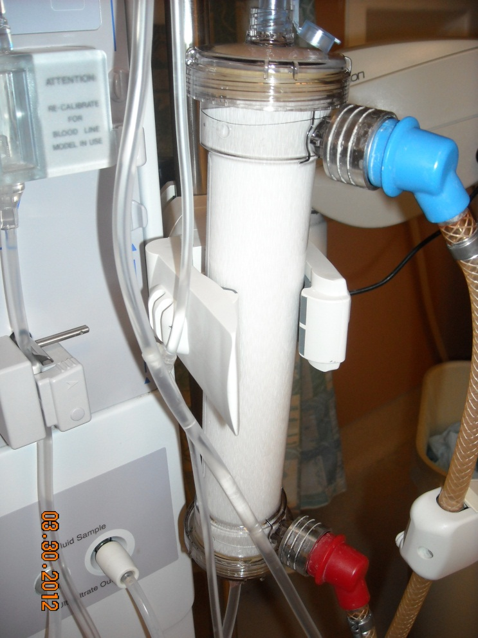
Safe Handling of Dialyzers & Blood Tubing
Before removing or transporting used dialyzers & blood tubing, cap dialyzer ports & clamp tubing.
Place all used dialyzers & tubing in leak-proof containers for transport from station to reprocessing or disposal area.
If dialyzers are reused, follow AAMI published methods for reprocessing.
AAMI is the Association for the Advancement of Medical Instrumentation
Notes:
The last concept in the dialysis-specific infection control recommendations is to practice safe handling of used dialyzers and blood tubing.
Before removing or transporting used dialyzers and blood tubing, cap dialyzer ports and clamp tubing. Place all used dialyzers and tubing in leak-proof containers for transport from station to reprocessing or disposal area. If dialyzers are reused, initiate reprocessing immediately after use and follow published methods, for example, AAMI standards, for reprocessing the dialyzers.

Slide 22
Concerns about Catheter
Sometimes, even when you are very careful, your access may clot or become infected.
Clots
Can form inside the opening of the catheter or form on the outside of the catheter & block the opening.
Causes blood to flow at a slower rate.
If the blood flow rate remains low for more than one dialysis treatment, catheter should be checked & treated same day.
Early treatment may prevent the clot from totally blocking the catheter.

Slide 23
Concerns about Catheter
Infection
Can occur even with a good blood flow rate.
It is important to follow catheter care instructions in order to avoid infection.
Following are signs & symptoms of a catheter infection. Report them right away, to get the proper treatment as quickly as possible.
Fever
Chills
Drainage from the catheter exit site
Redness or tenderness around the catheter exit site
General feeling of weakness and illness

Slide 24
Concerns about Catheter
Catheter not working well
Decrease in blood flow rate ordered by doctor is a sign that catheter is not working as it should.
If this occurs for more than one treatment in a week, the catheter should be checked.
The lower blood flow rate will cause you to receive less dialysis & may need a longer than usual haemodialysis treatment.
Another sign that the catheter is not working well may be the pre-pump arterial pressure alarms. These sounds notifies that the catheter (or other vascular access) is not allowing a free draw of blood.
This can be a sign that a clot is forming in the catheter blocking the flow of blood.

Slide 25
Taking Care of the Catheter
By taking good care of access, it will last longer & will prevent problems such as infection & clotting. Some of the precautions to be followed are:
Keep catheter dressing clean & dry.
Make sure the area of insertion site is clean & change dressing at each dialysis session.
Never remove cap on the end of the catheter. Air must not enter the catheter.
Wear a mask & gloves anytime the catheter is opened.
The caps & clamps of catheter should be kept tightly closed when not being used for dialysis.
Know your patients Kt/V & URR (urea reduction ratio). National Kidney Foundation recommends using Kt/V. If a patient is receiving enough dialysis, Kt/V should be at least 1.2. If URR is used, it should be 65 % or more. If these numbers are too low, one possible cause may be that the access is not working well. Further investigation and management may be needed.

Slide 26
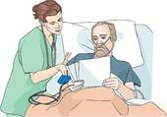
Educating the Patient is a Key
Educate the patient or their relative on the following:
How to change dressings in an emergency.
Only the dialysis team should use dialysis catheter to draw blood or to give medications or fluids.
Not to shower or swim; may take baths. One must not wet catheter site or catheter dressing. Moisture can cause infection. Taking a bath is safe if you do not allow catheter or catheter dressing to get wet.

Slide 27
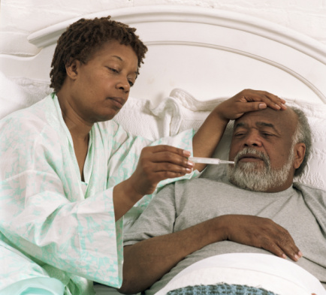
How to Recognize an Infection
Advise patients to inform if they notice any of the following possible signs of infection:
Fever
The access site is:
Swollen (bulging),
red,
warm, or
has pus
Severe pain at the access site
Remember: infections of the vascular access site can be life threatening
Notes:
First, please advise all patients and their caregivers on how to recognize an infection. They should tell you or another healthcare worker if they notice any of the following signs of infection:
Fever
The access site is swollen or bulging, red, warm, or there is pus at the site
Severe pain at the access site
Remember that infections of the vascular access site can be life threatening.

